Slide 1
Final Exam Review Slides

Slide 2
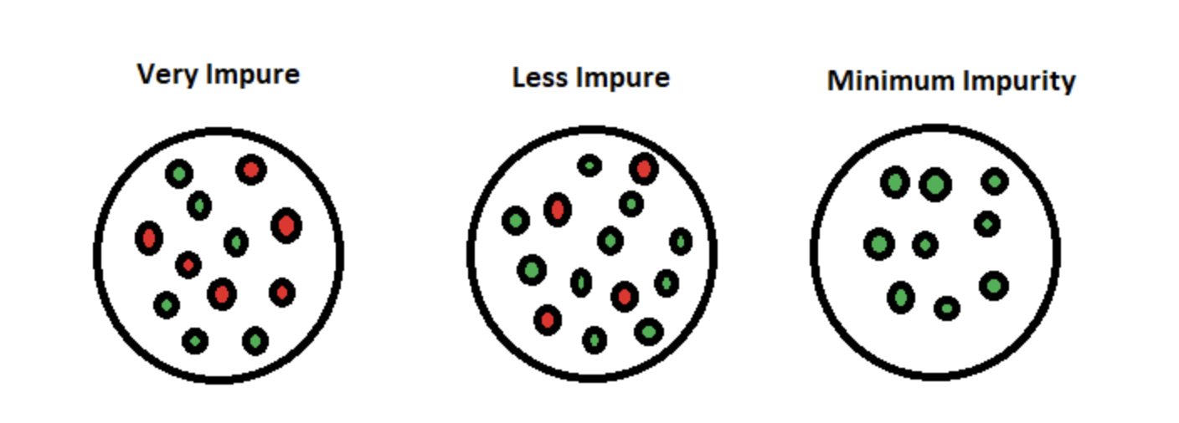
Entropy
Image Credit: https://www.section.io/engineering-education/entropy-information-gain-machine-learning/

Slide 3
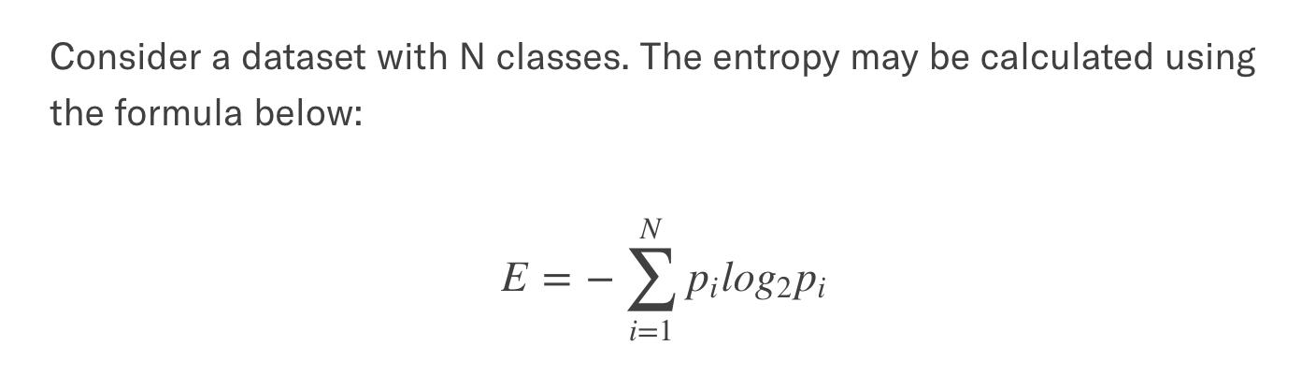
Entropy
Where $p_{i}$ is the probability of class i in a given set
Image Credit: https://www.section.io/engineering-education/entropy-information-gain-machine-learning/

Slide 4
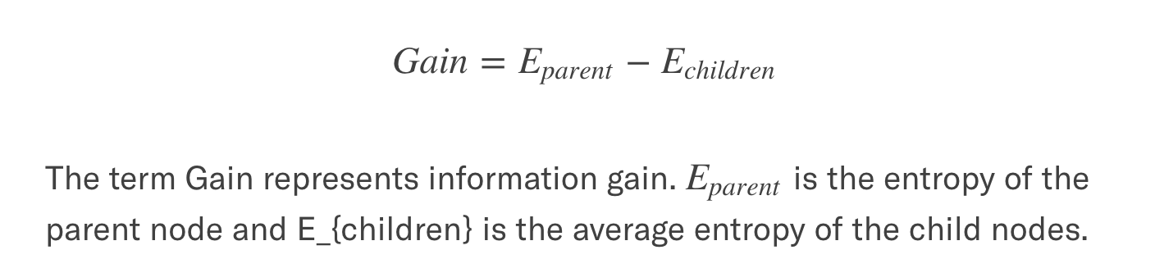
Information Gain
Image Credit: https://www.section.io/engineering-education/entropy-information-gain-machine-learning/

Slide 5
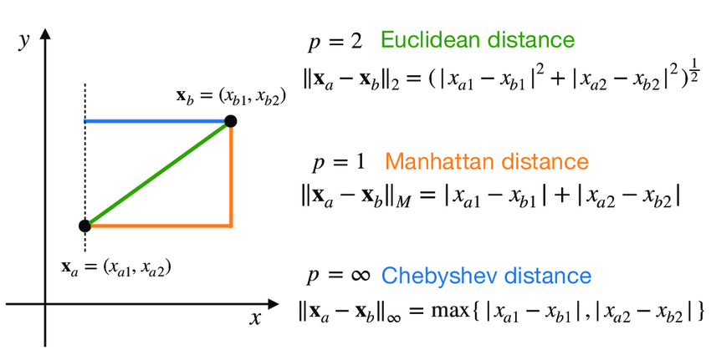
Distances

Slide 6
Nearest Neighbors Clustering
Not completed yet

Slide 7
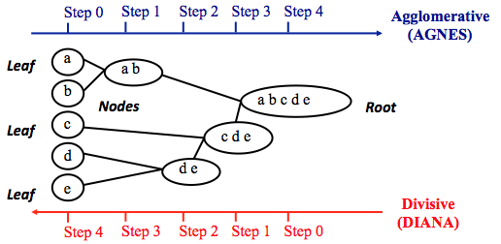
Hierarchical Agglomerative Clustering

Slide 8
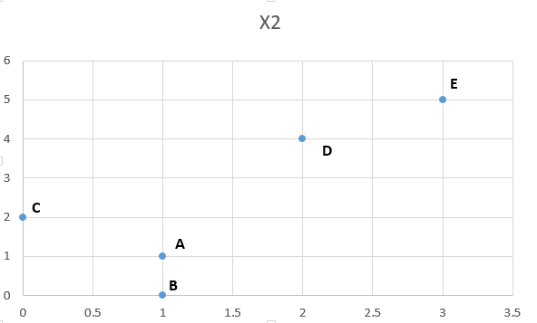
Example
 | X1 | X2
A | 1 | 1
B | 1 | 0
C | 0 | 2
D | 2 | 4
E | 3 | 5
 | A | B | C | D | E
A | 0.0
B | 1.0 | 0.0
C | 1.4 | 2.2 | 0.0
D | 3.2 | 4.1 | 2.8 | 0.0
E | 4.5 | 5.4 | 4.2 | 1.4 | 0.0
Start off assuming each point is its own cluster

Slide 9
Step1 find the smallest distance
Find smallest distance (in this case, average linkage is used. Whatever linkage method is used is what goes in this matrix)
 | A | B | C | D | E
A | 0.0
B | 1.0 | 0.0
C | 1.4 | 2.2 | 0.0
D | 3.2 | 4.1 | 2.8 | 0.0
E | 4.5 | 5.4 | 4.2 | 1.4 | 0.0
Linkage by average

Slide 10
Step1 find the smallest distance
Find smallest distance (in this case, average linkage is used. Whatever linkage method is used is what goes in this matrix)
 | A | B | C | D | E
A | 0.0
B | 1.0 | 0.0
C | 1.4 | 2.2 | 0.0
D | 3.2 | 4.1 | 2.8 | 0.0
E | 4.5 | 5.4 | 4.2 | 1.4 | 0.0
Linkage by average

Slide 11
Step1 find the smallest distance
Find smallest distance (in this case, average linkage is used. Whatever linkage method is used is what goes in this matrix)
 | A | B | C | D | E
A | 0.0
B | 1.0 | 0.0
C | 1.4 | 2.2 | 0.0
D | 3.2 | 4.1 | 2.8 | 0.0
E | 4.5 | 5.4 | 4.2 | 1.4 | 0.0
 | A | B | C | D | E
A | 0.0
B | 1.0 | 0.0
C | 1.4 | 2.2 | 0.0
D | 3.2 | 4.1 | 2.8 | 0.0
E | 4.5 | 5.4 | 4.2 | 1.4 | 0.0
Take average, calculate distances to new cluster
 | AB | C | D | E
AB | 0.0
C | 1.8 | 0.0
D | 3.6 | 2.8 | 0.0
E | 4.9 | 4.2 | 1.4 | 0.0
Merge two clusters
Linkage by average

Slide 12
Dendrogram
Distance
1
AB
Clusters that have distance (linkage criteria) = 1
0
Clusters that have distance (linkage criteria) = 0
Minimum distance at 1
A
B
 | A | B | C | D | E
A | 0.0
B | 1.0 | 0.0
C | 1.4 | 2.2 | 0.0
D | 3.2 | 4.1 | 2.8 | 0.0
E | 4.5 | 5.4 | 4.2 | 1.4 | 0.0
 | AB | C | D | E
AB | 0.0
C | 1.8 | 0.0
D | 3.6 | 2.8 | 0.0
E | 4.9 | 4.2 | 1.4 | 0.0
Linkage by average

Slide 13

Perform again (find smallest distance, merge two clusters)
 | AB | C | D | E
AB | 0
C | 1.8 | 0.0
D | 3.6 | 2.8 | 0.0
E | 4.9 | 4.2 | 1.4 | 0.0
Smallest distance is between D and E

Slide 14
Merge
 | AB | C | D | E
AB | 0
C | 1.8 | 0.0
D | 3.6 | 2.8 | 0.0
E | 4.9 | 4.2 | 1.4 | 0.0
Take average for distance
 | AB | C | DE
AB | 0
C | 1.8 | 0.0
DE | 4.3 | 3.5 | 0.0

Slide 15
Dendrogram
 | AB | C | D | E
AB | 0
C | 1.8 | 0.0
D | 3.6 | 2.8 | 0.0
E | 4.9 | 4.2 | 1.4 | 0.0
Minimum distance at 1.4
1.4
DE
1
AB
1
0
0
D
E
A
B
C
 | AB | C | DE
AB | 0 | 1.8 | 4.3
C | 1.8 | 0.0 | 3.5
DE | 4.3 | 3.5 | 0.0

Slide 16
Do it again
 | AB | C | DE
AB | 0
C | 1.8 | 0.0
DE | 4.3 | 3.5 | 0.0
Smallest distance

Slide 17
Do it again
 | AB | C | DE
AB | 0
C | 1.8 | 0.0
DE | 4.3 | 3.5 | 0.0
 | ABC | DE
ABC | 0
DE | 4 | 0.0
Merge into new cluster

Slide 18
Dendrogram
1.8
ABC
1.4
DE
1
1
AB
Minimum distance at 1.8
0
0
D
E
A
B
C
 | AB | C | DE
AB | 0
C | 1.8 | 0.0
DE | 4.3 | 3.5 | 0.0

Slide 19
Dendrogram
4
ABCDE
1.8
ABC
1.4
Minimum distance at 4
DE
1
1
AB
0
0
D
E
A
B
C
 | ABC | DE
ABC | 0
DE | 4 | 0.0

Slide 20
Threshold
4
ABCDE
2 clusters at threshold 3
1.8
ABC
2 clusters and one outlier at threshold 1.5
1.4
DE
1
1
Outlier = cluster with 1 element
AB
0
0
D
E
A
B
C
Optimal threshold can be the mid point of the longest branch 4/2=2

Slide 21
Linkage Methods of Clustering
Single Linkage
These are different ways to fill in the distance matrix
Minimum Distance
Cluster 1
Cluster 2
Complete Linkage
Maximum Distance
Cluster 1
Cluster 2
Average Linkage
Average Distance
Cluster 1
Cluster 2

Slide 22
Other Agglomerative Clustering Methods
Ward’s Procedure
These are different ways to fill in the distance matrix
Centroid Method

Slide 23
K-means Algorithm
Initialisation: set centroid points (randomly)
While(avg. intra-cluster distance is large OR num_iterations is reached):
Assign each object to the cluster of the nearest centroid
Compute new centroid for each cluster (the centroid is the centre, i.e., mean point, of the cluster)

Slide 24
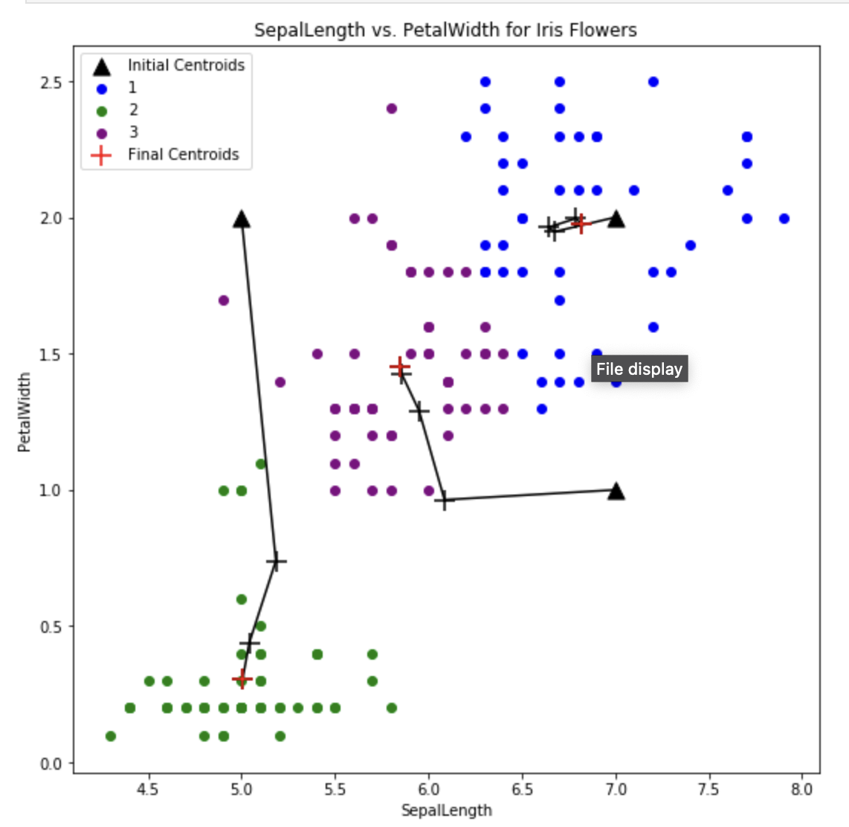
K-Means
Image Credit: https://github.com/ChadWeatherly/UHD_DATA_4319/blob/master/K-Means%20Clustering/K-Means%20Clustering.ipynb

Slide 25
What is Cluster Analysis?
Cluster: a collection of data objects
Similar to one another within the same cluster
Dissimilar to the objects in other clusters
Cluster analysis
Finding similarities between data according to the characteristics found in the data and grouping similar data objects into clusters
Unsupervised learning: no predefined classes
Typical applications
As a stand-alone tool to get insight into data distribution
As a preprocessing step for other algorithms

Slide 26
Measure the Quality of Clustering
Dissimilarity/Similarity metric: Similarity is expressed in terms of a distance function, which is typically metric: d(i, j)
There is a separate “quality” function that measures the “goodness” of a cluster.
The definitions of distance functions are usually very different for interval-scaled, boolean, categorical, ordinal and ratio variables.
It is hard to define “similar enough” or “good enough”
the answer is typically highly subjective.

Slide 27
Intra-cluster and Inter-cluster distances
Inter-cluster distances are maximized
Intra-cluster distances are minimized

Slide 28
What is good clustering?
A good clustering method will produce high quality clusters with
high intra-class similarity (data points within a cluster are similar)
low inter-class similarity (data points in different clusters are very different)
The quality of a clustering result depends on
the similarity measure used
implementation of the similarity measure
The quality of a clustering method is also measured by its ability to discover some or all of the hidden patterns

Slide 29
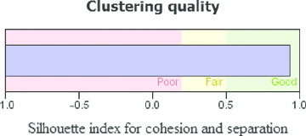
Silhouette Coefficient
Silhouette Coefficient combines ideas of both cohesion and separation
For an individual point, i
Calculate a = average distance of i to the points in its cluster( Smaller the value better the assignment)
Calculate b = min (average distance of i to points in another cluster)
The silhouette coefficient for a point is then given by
s = 1 – a/b if a < b,
(s = b/a - 1 if a ≥ b, not the usual case)
Typically between 0 and 1
The closer to 1 the better
b
a
29

Slide 30
Silhouette Coefficient…continue
S.A. is a way to measure how close each point in a cluster is to the points in its neighboring clusters
Its a neat way to find out the optimum value for k during k-means clustering.
Silhouette values lies in the range of [-1, 1]. A value of +1 indicates that the sample is far away from its neighboring cluster and very close to the cluster its assigned. Similarly, value of -1 indicates that the point is close to its neighboring cluster than to the cluster its assigned. And, a value of 0 means its at the boundary of the distance between the two cluster. Value of +1 is idea and -1 is least preferred.

Slide 31
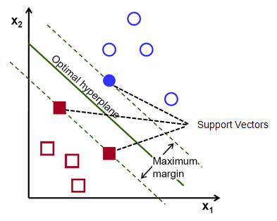
SVM
https://www.youtube.com/watch?v=_YPScrckx28

Slide 32
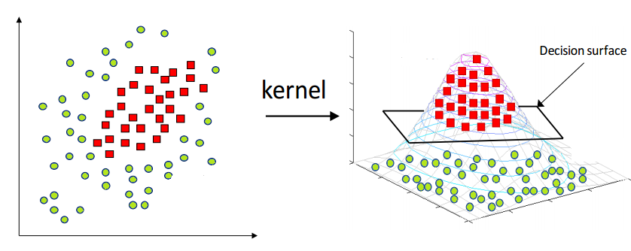
SVM Kernel
https://scikit-learn.org/stable/modules/generated/sklearn.svm.SVC.html
Know parameters
φ
Function to map the data (transform ) from N-dimensional space to another M-dimensional space using a “kernel” function. In this new space, decision boundaries may be easier to find

Slide 33
Processing Information in ANN
A single neuron (processing element – PE) with inputs and outputs

Slide 34
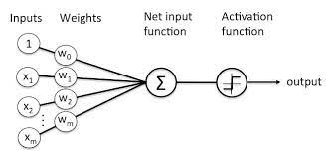
Perceptron

Slide 35
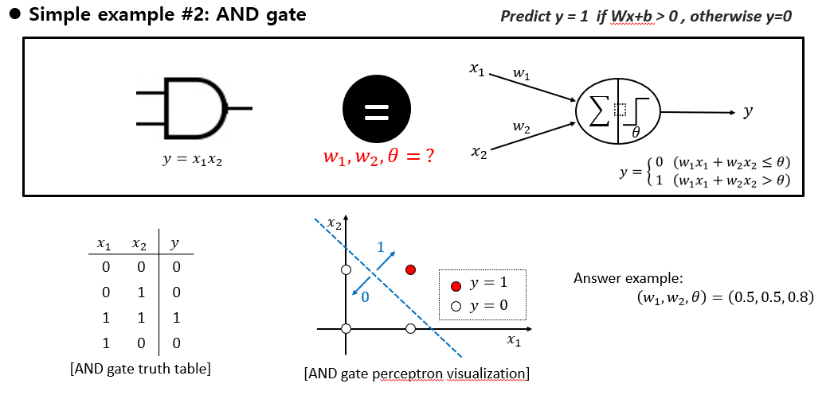
Use Perceptron to re-produce AND logical operator

Slide 36
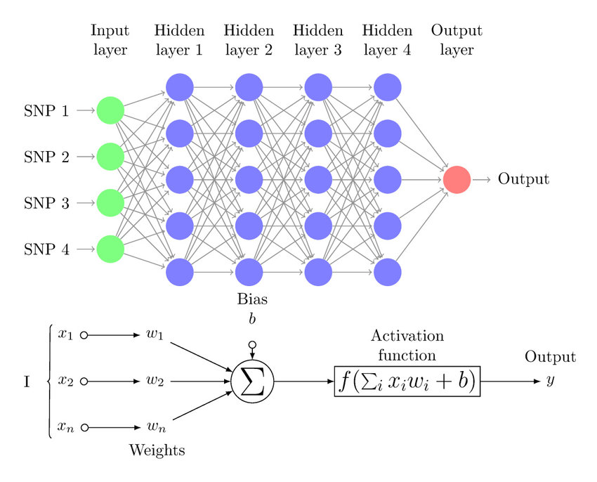
Multi-Layer Perceptron ( ANN )

Slide 37
Multi-Layer Perceptron ( ANN )
Loss function is a function of many parameters, the weights of the MLP / ANN !
Weights are slowly tweaked to improve Loss function (Gradient Descent)
For more info, if you want more intuition/mathematics not needed for test:
https://www.youtube.com/watch?v=aircAruvnKk&list=PLZHQObOWTQDNU6R1_67000Dx_ZCJB-3pi

Slide 38
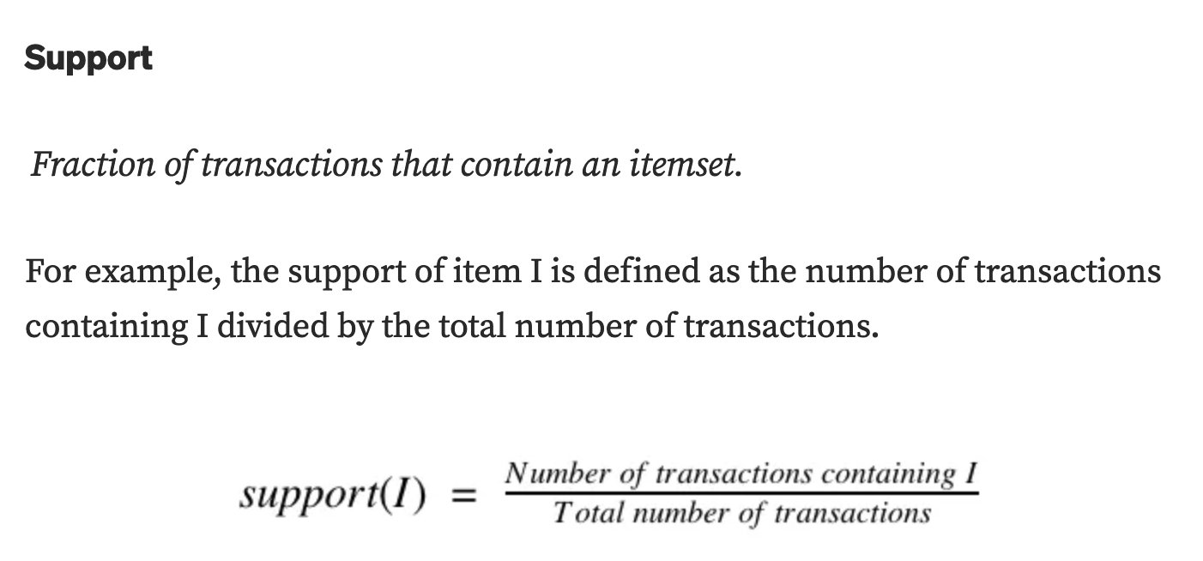
Association Analysis: A priori
Definitions
Image Credit: https://towardsdatascience.com/apriori-association-rule-mining-explanation-and-python-implementation-290b42afdfc6

Slide 39
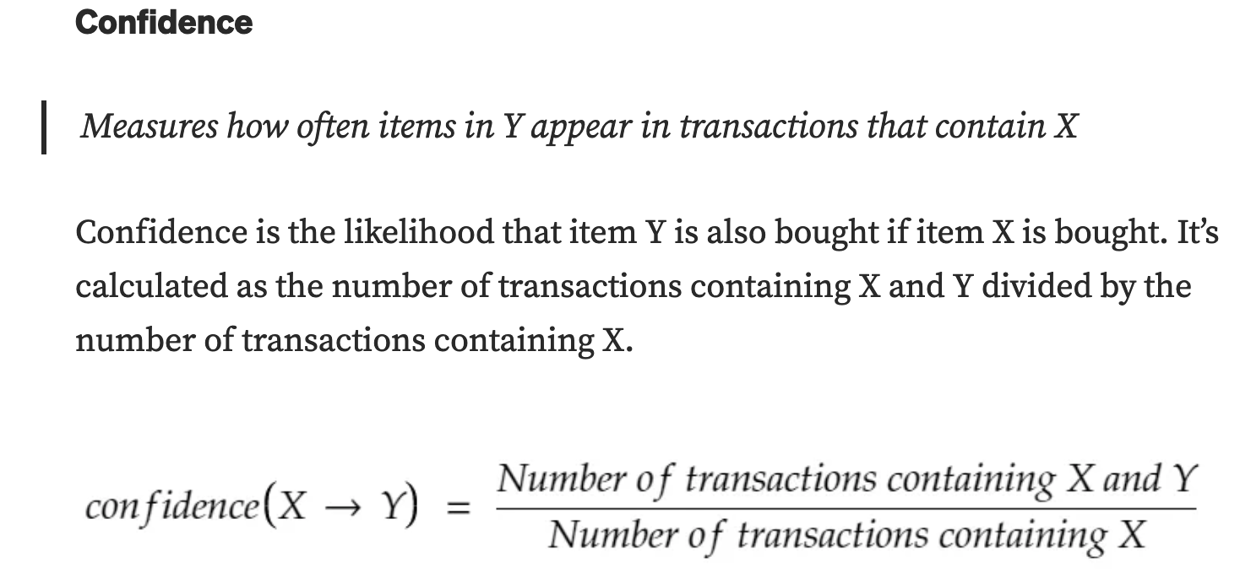
Association Analysis: A priori
Definitions
Image Credit: https://towardsdatascience.com/apriori-association-rule-mining-explanation-and-python-implementation-290b42afdfc6

Slide 40
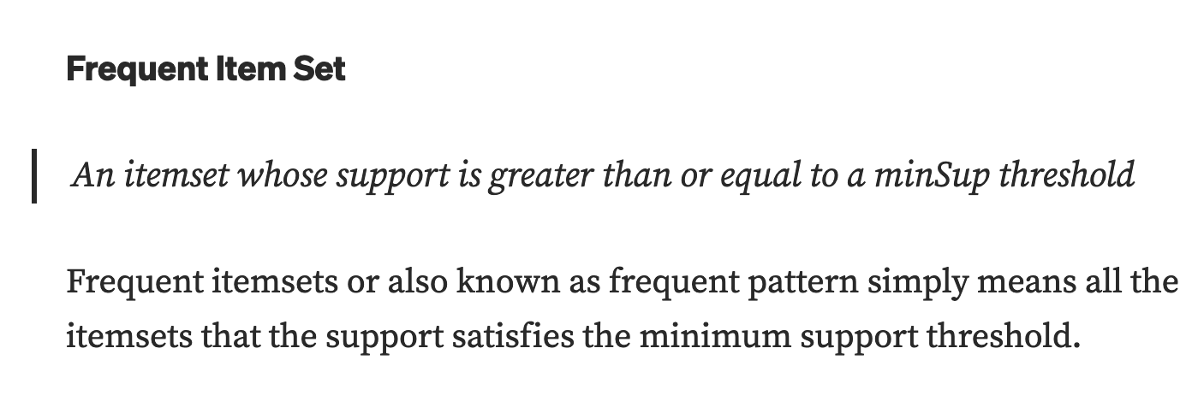
Association Analysis: A priori
Definitions (minSup = minimum support)
Image Credit: https://towardsdatascience.com/apriori-association-rule-mining-explanation-and-python-implementation-290b42afdfc6

Slide 41
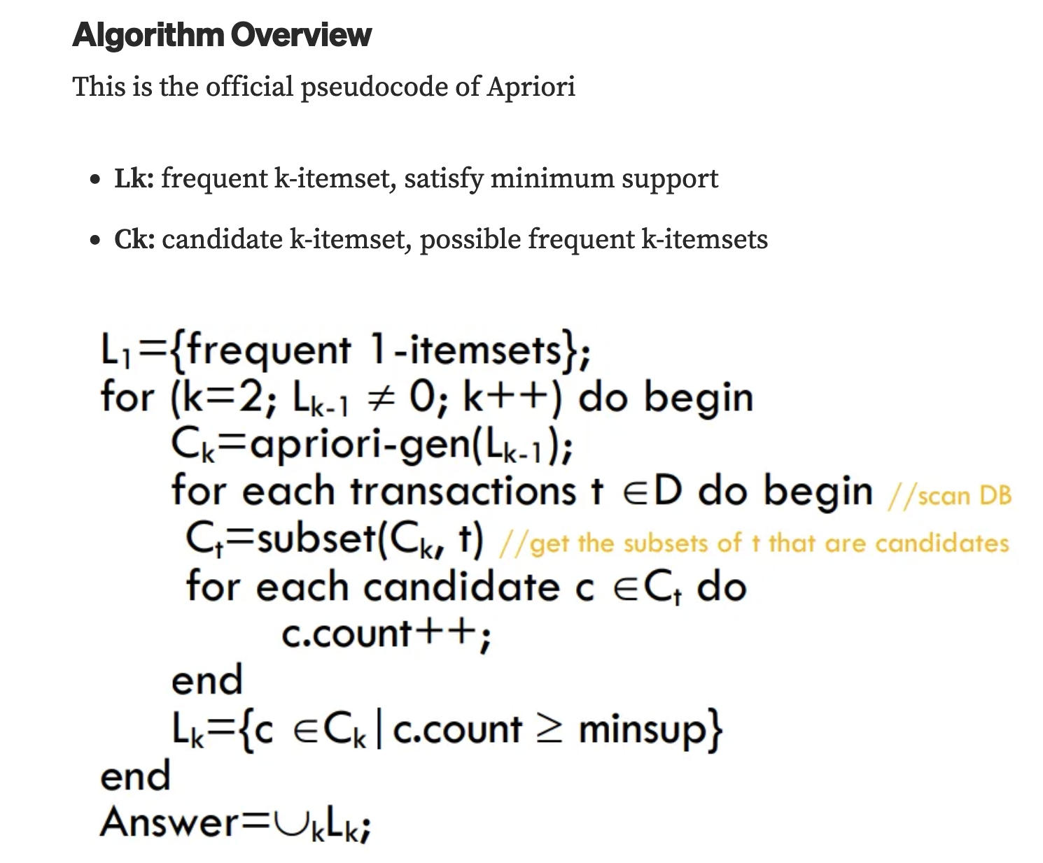
Association Analysis: A priori
Image Credit: https://towardsdatascience.com/apriori-association-rule-mining-explanation-and-python-implementation-290b42afdfc6

Slide 42
The Apriori Algorithm — Example
Database D
L₁
C₁
Scan D
C₂
C₂
L₂
Scan D
C₃
Scan D
L₃

Slide 43
The Apriori Algorithm — Example
Database D
L₁
C₁
Scan D
C₂
C₂
L₂
Scan D
C₃
Scan D
L₃
Final item-set is used to create rules based on confidence levels

Slide 44
The Apriori Algorithm — Example
L₃
Check all possible rules
2 => (3, 5)
Conf. = (2) / (2) = 1
3 => (2, 5)
C = (2) / (2) = 1
5 => (2, 3)
C = (2) / (2) = 1
(2, 3) => 5
C = (2) / (2) = 1
(2, 5) => 3
C = (2) / (3) = 0.67
(3, 5) => 2
C = (2) / (2) = 1
Database D

Slide 45
The Apriori Algorithm — Example
L₃
Check all possible rules
2 => (3, 5)
Conf. = (2) / (2) = 1
3 => (2, 5)
C = (2) / (2) = 1
5 => (2, 3)
C = (2) / (2) = 1
(2, 3) => 5
C = (2) / (2) = 1
(2, 5) => 3
C = (2) / (3) = 0.67
(3, 5) => 2
C = (2) / (2) = 1
Then, we keep rules where
Confidence > min_confidence
Database D

Slide 46
Coding
Know how to create plots in Matplotlib
How to optimize parameters in a given model? (Exhaustive Search)

